Slide 1
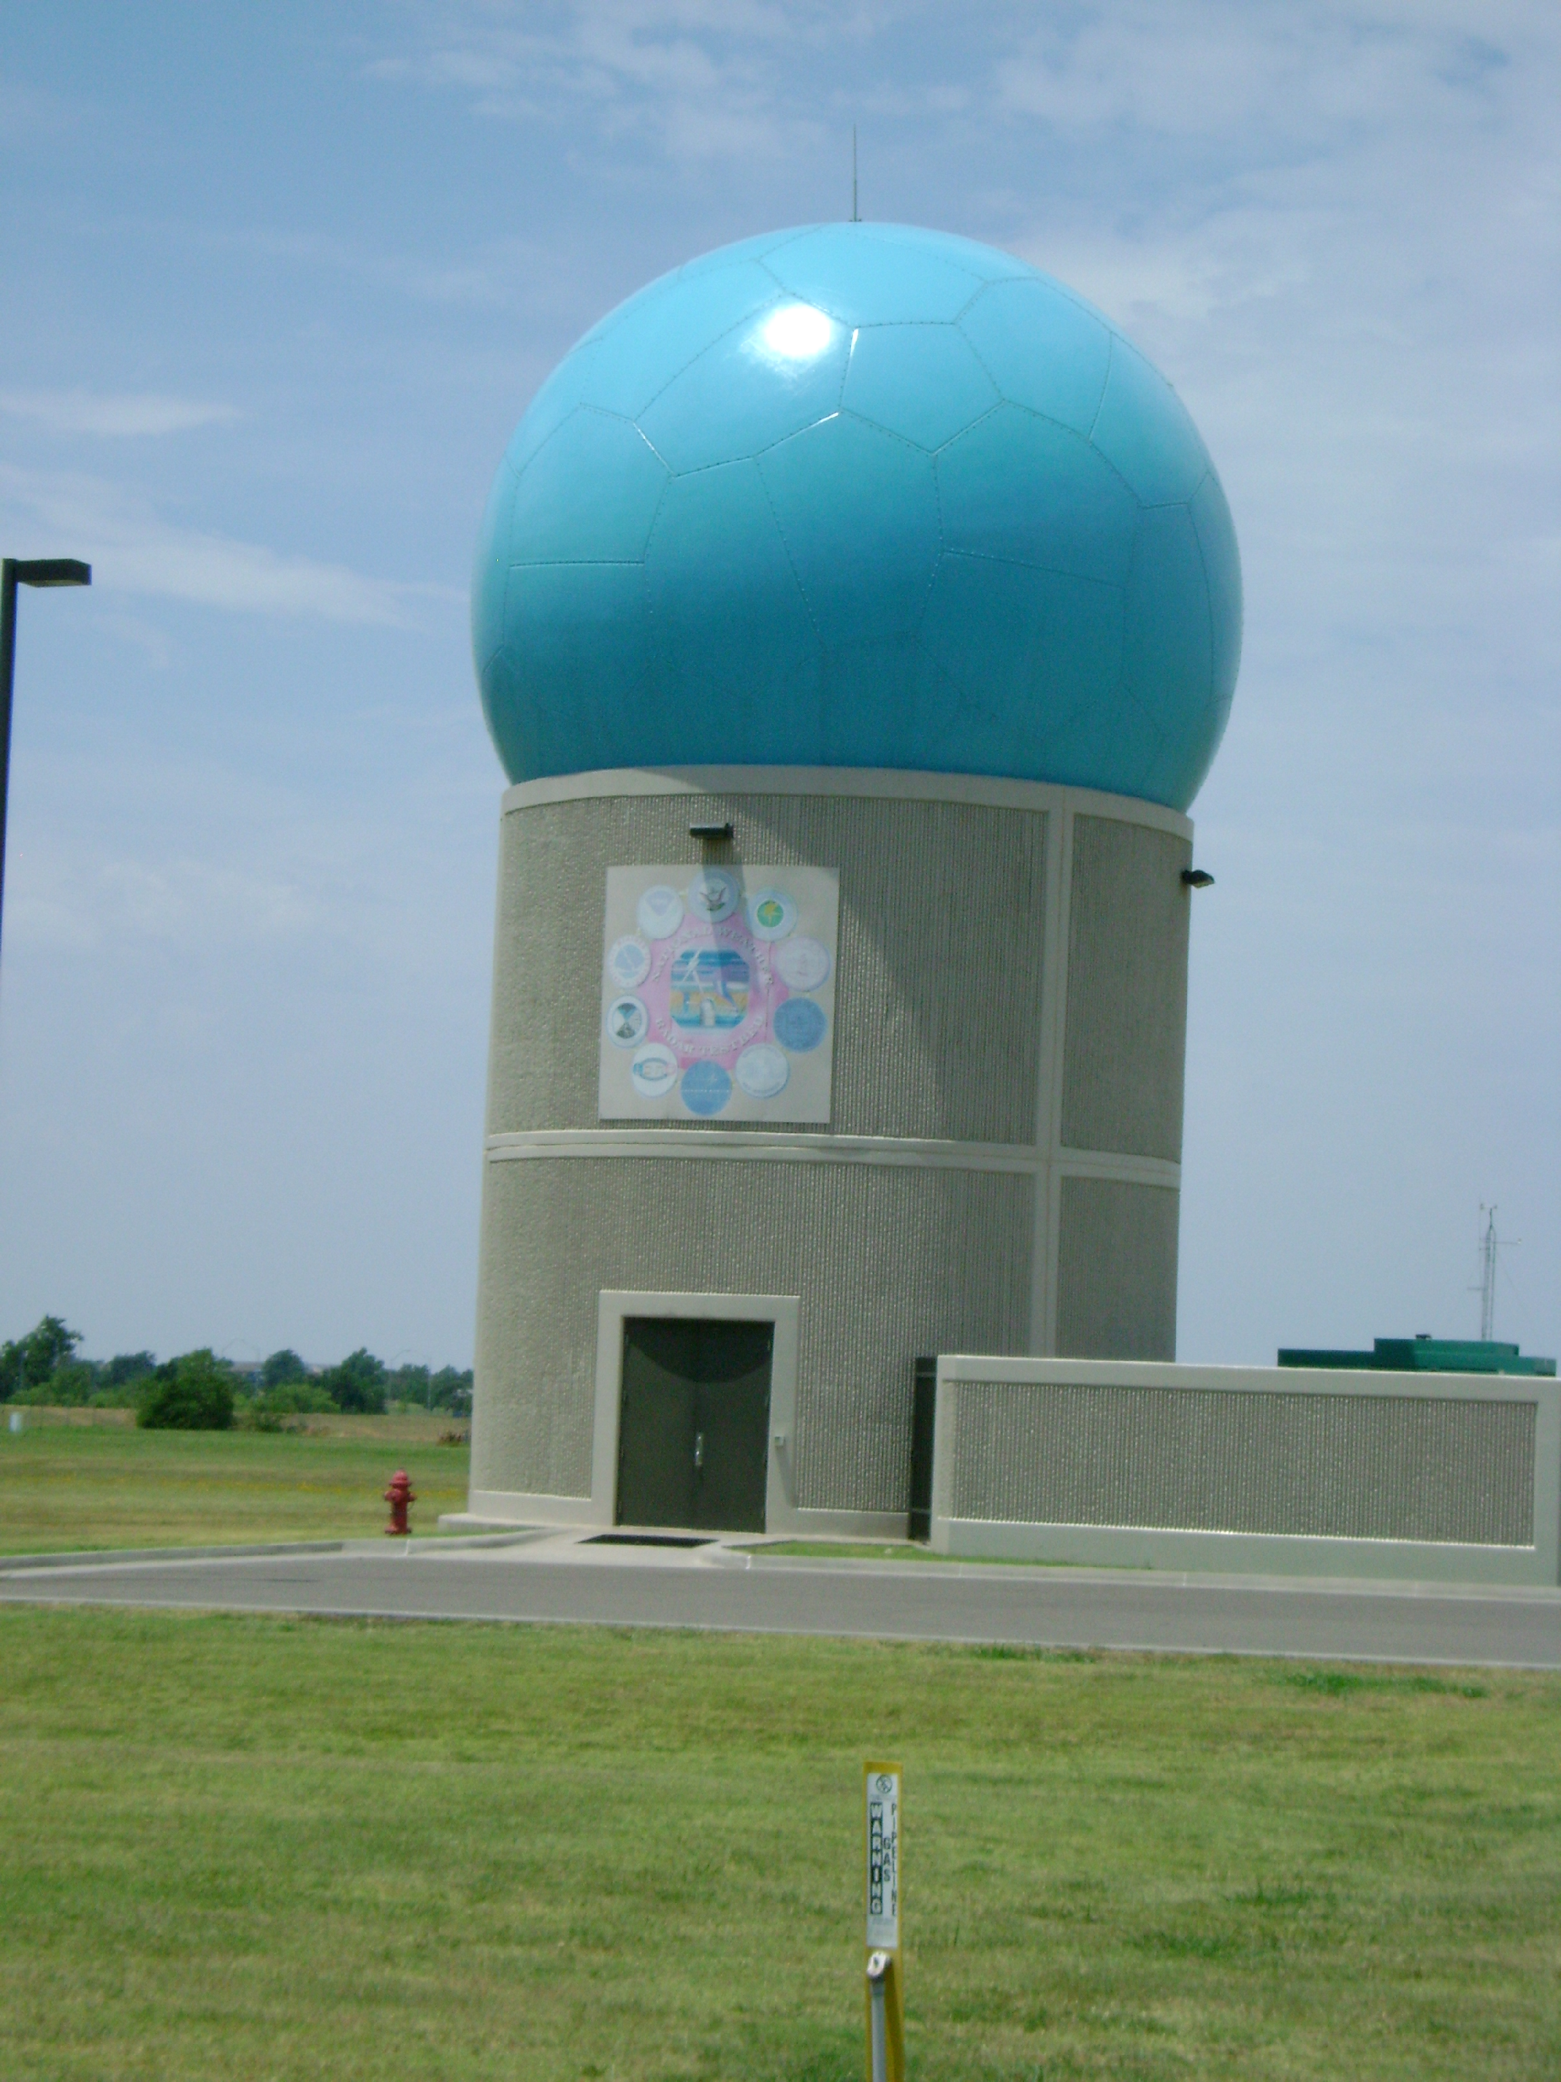
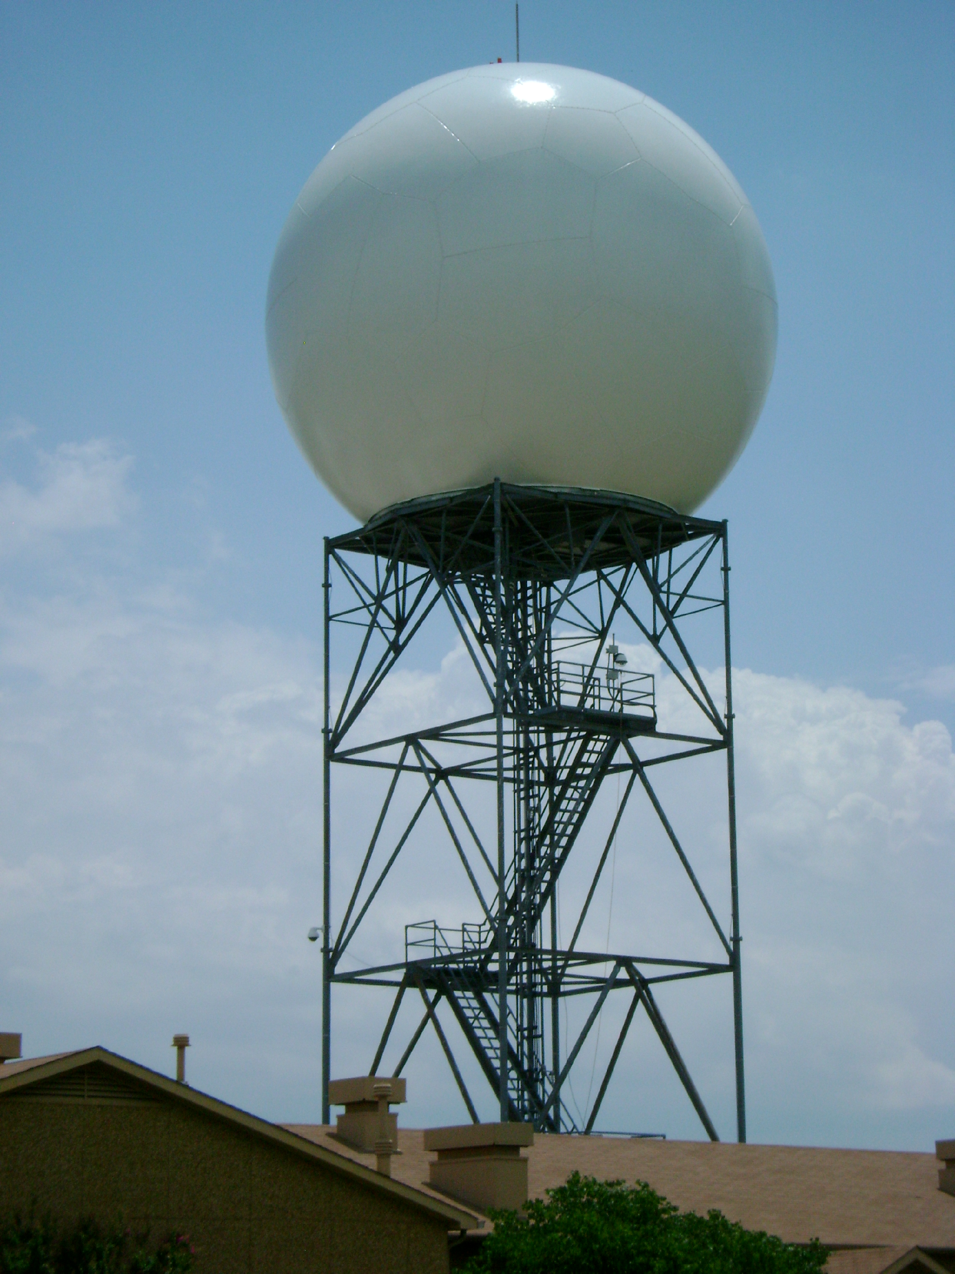
.
Phased Array Weather Radar Polarimetry: Status, challenges and solutions
???
Ang
ang
Guifu Zhang, Robert Palmer, Lei Lei, Shaya Karimkashi,
Richard J. Doviak, Dusan S. Zrnic, and Yasser Al-Rashid
OU/NSSL/LM

Slide 2
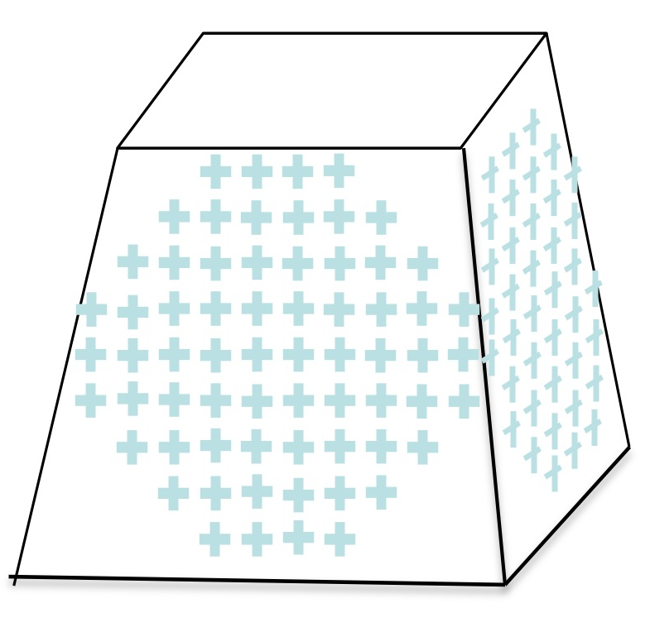
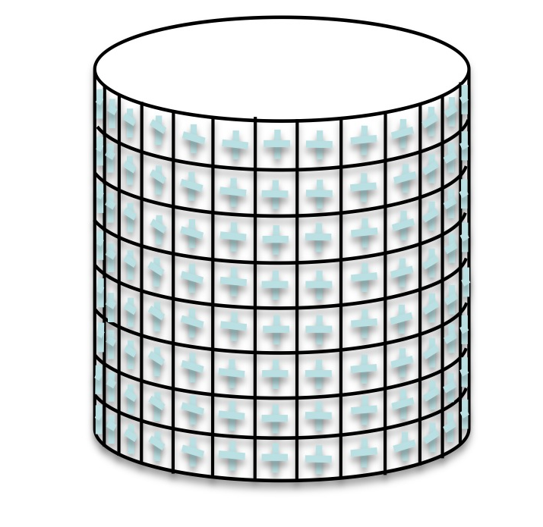
Outline
Current status of weather radar polarimetry
Challenges and limitations for Planar Polarimetric Phased Array Radar (PPPAR)
Possible solutions:
  Calibration for PPPAR measurements
  Symmetric configuration: Cylindrical Polarimetric PAR (CPPAR)

Slide 3
Weather Radar Polarimetry
More information obtained by transmitting and receiving dual-polarized waves
Scattering matrix is measured with two polarization modes
  Full scattering matrix measured with the Alternate Transmission and Simultaneous Reception (ATSR or AHV)
  Copolar scattering elements measured with the Alternate Transmission and Simultaneous Reception (STSR or SHV)

Slide 4
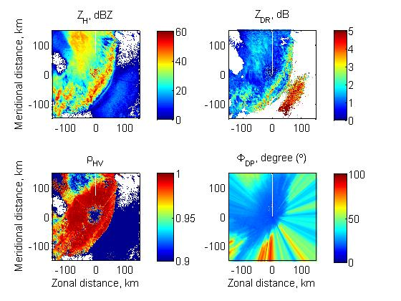
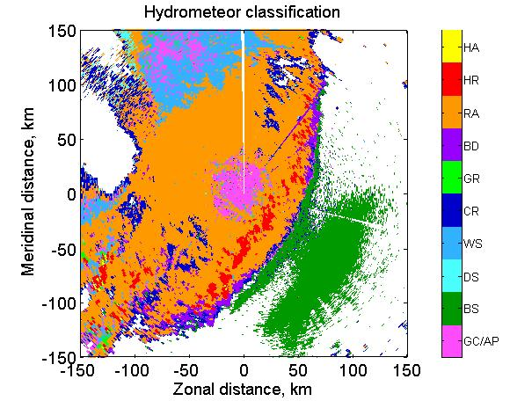
Polarimetric radar data and potentials
Reflectivity factor for horizontal/vertical polarization
Differential reflectivity
Cross-correlation coefficient
Specific differential phase
classification
Accurate QPE
Improve QPF

Slide 5
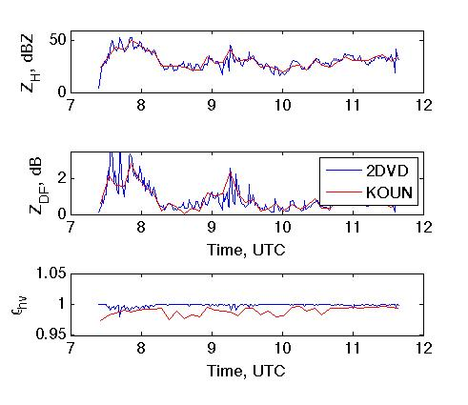
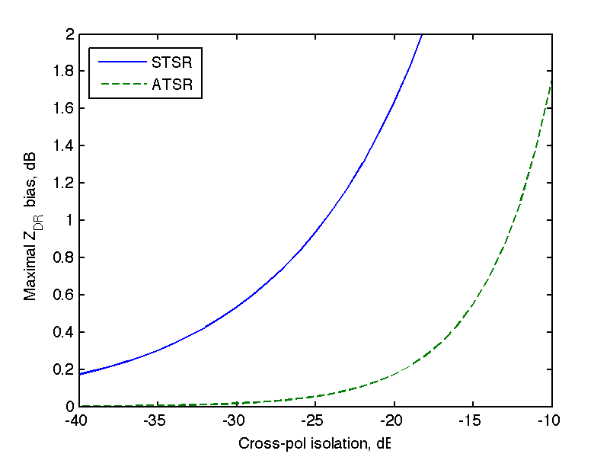
Challenges for PPAR
Accurate measurement needed for polarmetric radar variables desirable accuracy
  Z: 1 dB
  Z_{DR}: 0.1 dB
  ρ_{hv}: 0.01
Translated to system requirements
  High cross-pol isolation (40dB for STSR, 20 dB for ATSR)
  Matched beam patterns for H- & V-pol
Big challenges for phased-array radar because
  Gain changes depending on beam direction
  Polarization changes and becomes non-orthogonal

Slide 6
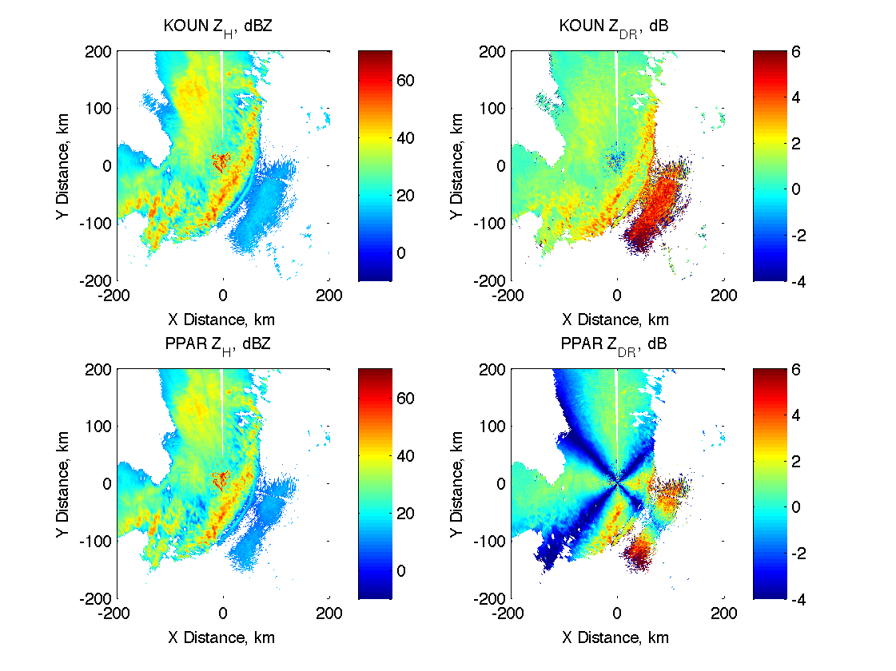
KOUN data versus simulated PPAR data
8.54 m
Polarization bias > 6 dB
Sensitivity loss > 7.5 dB

Slide 7
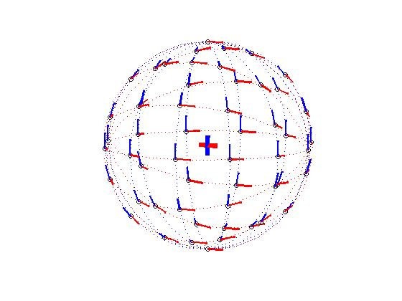
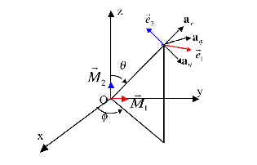
Polarization coupling and correction
Incident fields related to transmitting fields
PPAR scattering matrix Correction needed
  Zhang, G., R. J. Doviak, D. S. Zrnic, J. E. Crain, D. Staiman, and Y. Al-Rashid, 2009: Phased array radar polarimetry for weather sensing: A theoretical formulation for polarization calibration. IEEE Trans. on Geoscience and Remote Sensing, 47(11), 3679-3689, (4).

Slide 8
Bias expressions
ATSR
STSR
ZDRBias (ATSR)
ZDRBias (ATSR)

Slide 9
Z_{DR} bias for dipoles
ATSR
STSR
STSR
STSR
Parameters used in the calculation are: Z_{dr} = 1.0 (i.e., = 0 dB), ρ_{hv} = 0.9.
Notes:
9

Slide 10
Extended to Aperture and Patch
L
L
Lei L., G. Zhang, and R.J. Doviak, 2011: Bias Correction for Polarimetric Phased-Array Radar with different antenna radiation elements, to be submitted to IEEE Trans. on GRS.

Slide 11
Z_{DR} bias for aperture
STSR
STSR
Parameters used in the calculation are: Z_{dr} = 1.0 (i.e., = 0 dB), ρ_{hv} = 0.9.
Notes:
11

Slide 12
Z_{DR} bias for Patch
ATSR
STSR
STSR
STSR
Parameters used in the calculation are: Z_{dr} = 1.0 (i.e., = 0 dB), ρ_{hv} = 0.9.
Notes:
12

Slide 13
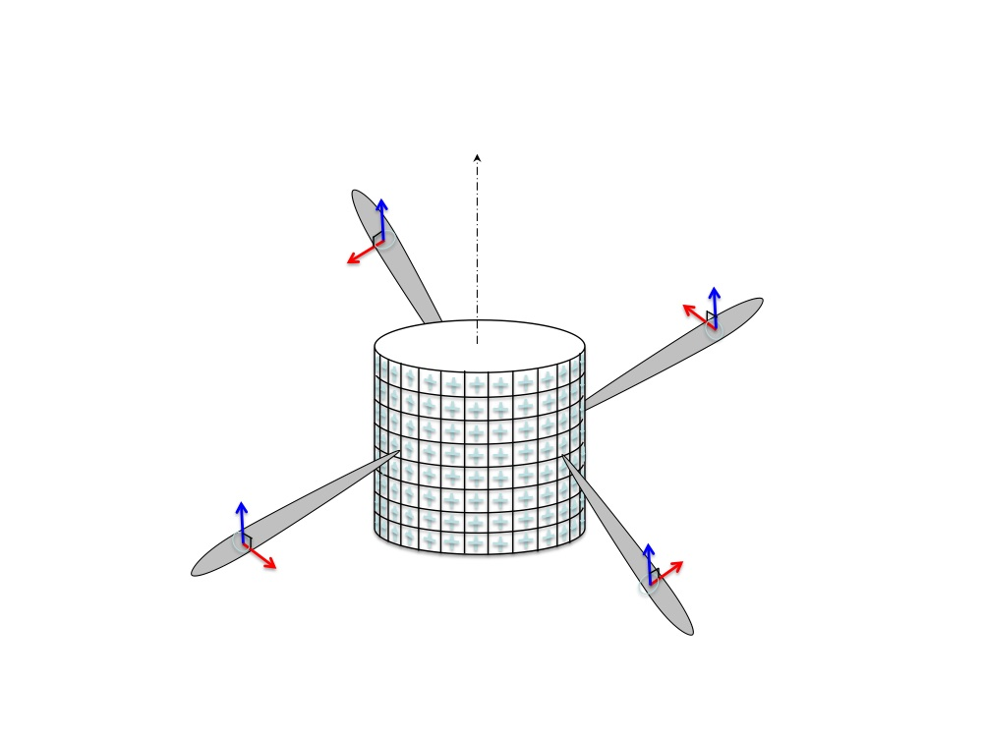
Cylindrical PPAR (CPPAR)
Azimuthally commutating scan
  Unique beam characteristics
  Polarization orthogonality
Zhang, G., R. J. Doviak, D. S. Zrnic, R. D. Palmer, L. Lei, Y. Al-Rashid, 2011: Polarimetric Phased Array Radar for Weather Measurement: A Planar or Cylindrical Configuration? J. Atmos. Ocean. Tech., 28(1), 63-73.

Slide 14
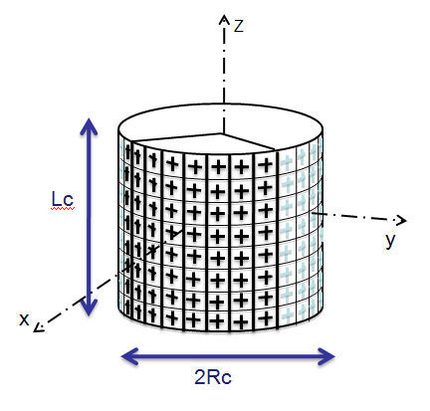
Optimization
The phase weights are chosen for beam pointing.
Amplitude weights are optimized
It is expensive to apply optimization
Invasive weed Optimization (IWO) is used with 30 iteration and 40 runs in each iteration.
dz = 0.65λ dr = 0.6λ
Lc = 8.54 m Rc = 6.0387 m
Nz=122 Nr = 148
Karimkashi, S., and A. A. Kishk, “Invasive weed optimizations and its feature in electromagnetics,” IEEE Trans. Antennas Propag., vol. 58, pp. 1269-1278, Apr. 2010.
Karimkashi, S., and G. Zhang, “An optimal design of a cylindrical phased array radar for weather sensing” submitted Radio Science., Apr. 2011.
Notes:
A two dimensional (2D) modified Bernstain polynomial

Slide 15
Cross-pol. minimization
(a)
+1
+1
+1
+1
(b)
-1
+1
-1
+1
Notes:
Cross pol is reduced comp to single elem

Slide 16
Advantages
Drawbacks
Scan-invariant polarimetric radar measurements
Polarization purity
High efficiency of utilizing radiation power and antenna aperture.
Efficient use of spectrum
Simultaneous multi-beam for multi-functionality
Flexibility to choose the number of beams
No need for the face-to-face matching
Complexity in design and manufacturing
Difficulty in controlling sidelobe levels
Synchronization
Sub-array production
Constrain on beam scan among formed beams

Slide 17
Conclusions and discussions
Radar polarimetry – a matured technique, many applications
PAR technology – great for multi-missions
Polarimetric PAR – must be done for MPAR
Many issues – great challenges and opportunities
Cylindrical array (CPPAR) – attractive configuration
Both PPPAR and CPPAR are possible for MPAR – TBD

Slide 18
On-going work presented
Session 2: Lei L., G. Zhang, R. Doviak, Design and Simulations for a Cylindrical Polarimetric Phased Array Weather Radar
Section 3: Zhang, Y., Y. Pan, S. Wang, Q. Zhao, D. Zrnic, R. Doviak, Reconfigurable and Scalable Array Element Design for Polarimetric Multifunctional
Session 5: Galletti, M., D. Zrnic, G. Zhang, R. Doviak, J. Crain, CPPAR – Cylindrical Polarimetric Phased Array Radar System Design

Slide 19
Single Element Microstrip Patch Design
RT/Druid 5880
Substrate Thickness = 3.175 mm
Frequency = 2.8 GHz
Length = 3.45 cm
Width = 3.45 cm

Slide 20
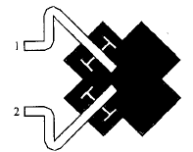
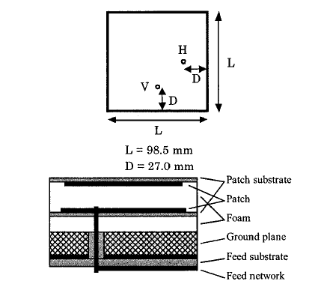
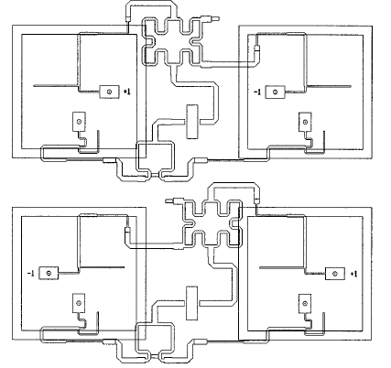
Single Element Microstrip Patch Design

Slide 21
Mutual Coupling Effect on the Element Pattern
Z
Y
Z
Y
Notes:
The same color

Slide 22
Conclusion
The desired radiation patterns of the cylindrical phased array was achieved.
The Xpol radiation pattern of the cylindrical phased array was suppressed by using the element mirroring method.
The full wave solution of the smaller array confirms the accuracy of obtained results.
Notes:
OU-NSSL CPPAR team and ARRC members

Slide 23
Optimization Challenges
1- The number of elements is more than 10000. Applying optimization to this problem means that more than 10000 variables should be optimized.
2- Since a beam with about one Degree is needed, a very high-resolution pattern is needed.
3- Since the sidelobe levels should not exceed a certain level in any angles or directions, the radiation pattern in the whole space should be computed.
applying optimization to this problem is very expensive since solving each single problem takes a few minutes. It should be noticed that we usually need more than 100,000 runs for such an optimization problem.

Slide 24
Inter-element Distance
Z
dz
y
dr
x
dz = 0.65λ dr = 0.6λ
Lc = 8.54 m Rc = 6.0387 m
Nz=122 Nr = 148
Notes:
Absorbers for cancelling SLL for increasin In. Spac

